Slide 1


Atliq Hardware's
Consumer Goods ‘Ad-hoc- insights
Presented By
Swathi G

Slide 2
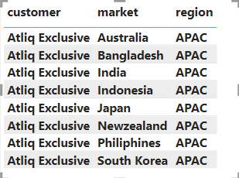
Request 1
Provide the list of markets in which customer “Atliq Exclusive” operates its business in the APAC region.

Slide 3
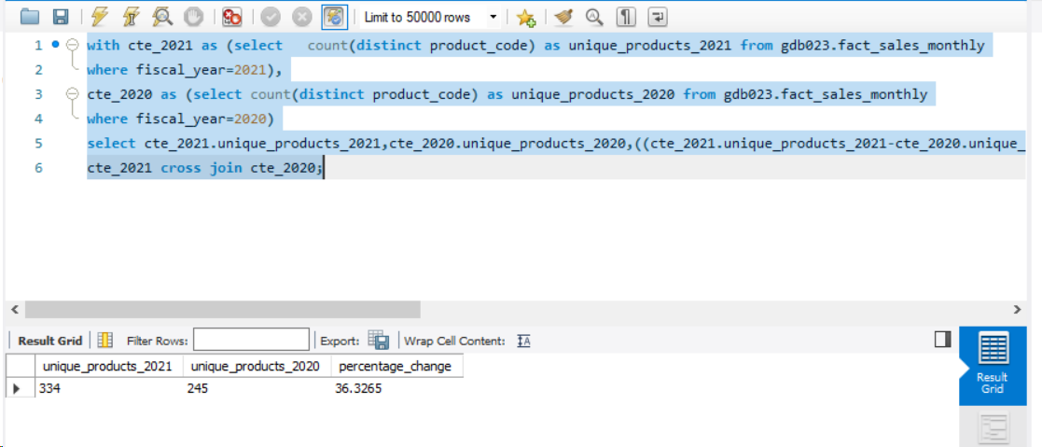
Request 2
What is the percentage of unique product increase in 2021 vs. 2020?

Slide 4
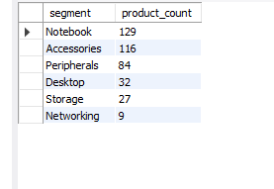
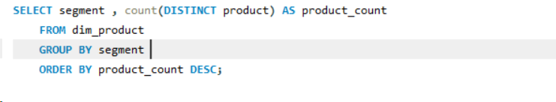
Request 3
Provide a report with all the unique product counts for each segment and sort them in descending order of product counts.

Slide 5
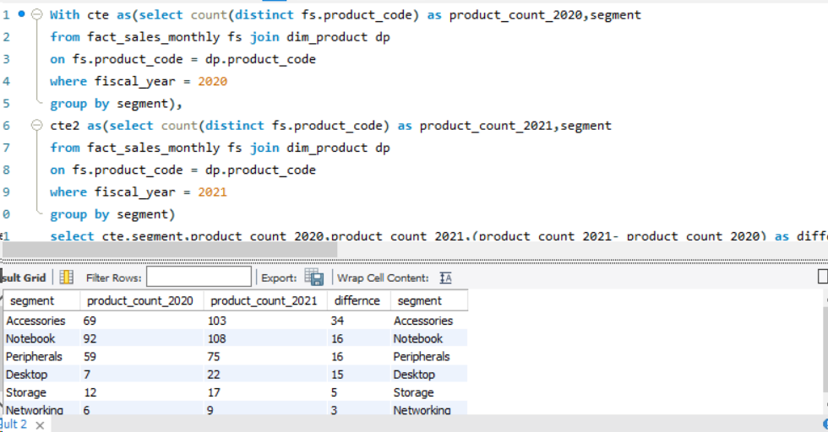
Request 4
Which segment had the most increase in unique products in 2021 vs 2020? The final output contains these fields,

Slide 6
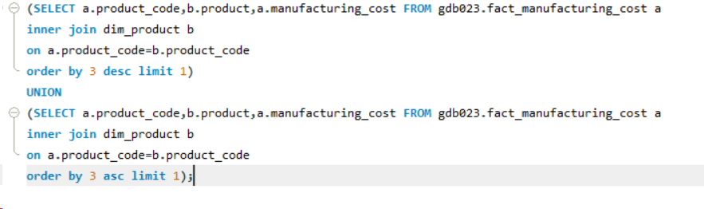
Request 5
Get the products that have the highest and lowest manufacturing costs.

Slide 7
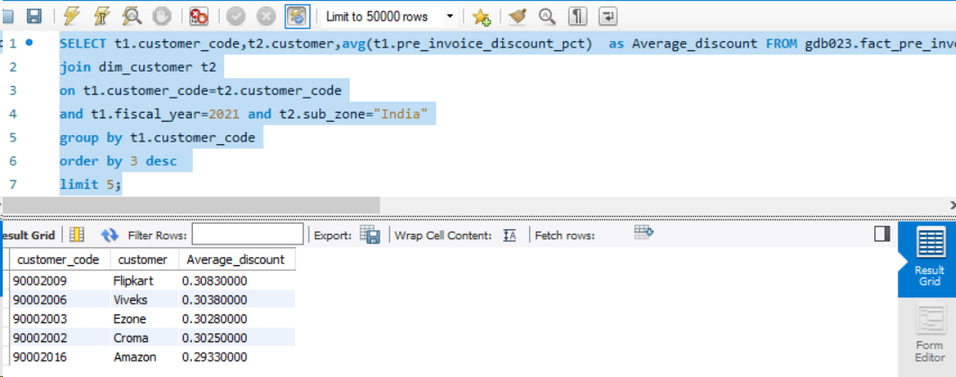
Request 6
Generate a report which contains the top 5 customers who received an average high pre_invoice_discount_pct for the fiscal year 2021 and in the Indian market.

Slide 8
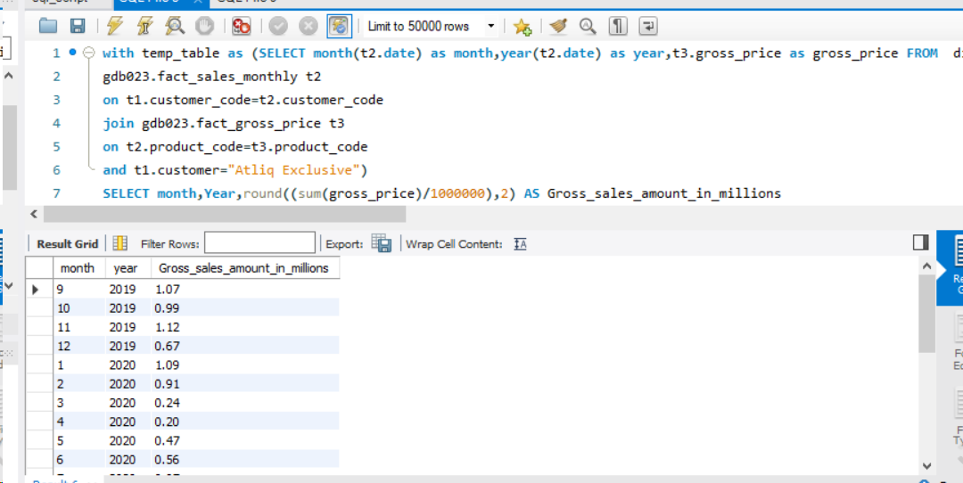
Request 7
Get the complete report of the Gross sales amount for the customer “Atliq Exclusive” for each month. This analysis helps to get an idea of low and high-performing months and take strategic decisions.

Slide 9
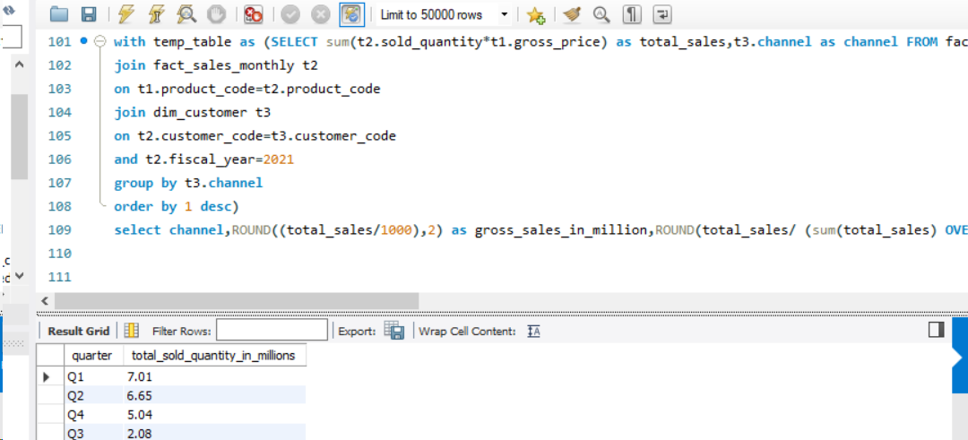
Request 8
In which quarter of 2020, got the maximum total_sold_quantity?

Slide 10
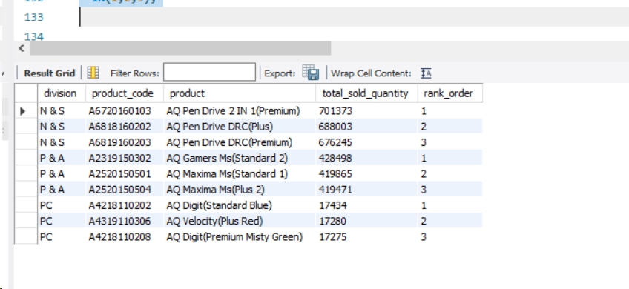

Request 9
Get the Top 3 products in each division that have a high total_sold_quantity in the fiscal_year 2021?

Slide 11
Thank You
Swathi G

